Slide 1
Learning to compose word groups by visually grounded embodied agents
Zijun, Haidi, Ganesh, Cheston

Slide 2
Experiments
Performance criteria >= 9
Train S1, Zero-shot S2: ??
Train S1, Zero-shot S3: ??
Init, Zero-shot S2: ??
Init, Zero-shot S3: ??
Train S1 then S2, Zero-shot S3: 5+
Train S2 only, Zero-shot S3: -5
Exps | 0-shot (s1>s2) | 0-shot (s1>s3) | train_1 | train_2 | train_3 | test_1 | test_2 | test_3 | 0-shot (s1-s2>s3) | train(S3) | test(S3)
S1 → S2 | 7.31/8.84/8.95 train 4.43/7.67/ 8.11 | -0.2/0.96/2.81 train -7.29/-3.36/-1.42 test | 808 | 612 | 493 | 1900 | 5576 | 8945 | train 5.86/5.26/5.35 test 5.72/5.01/5.93 | 8547 /7422 /5591 | 10600 /11600 /13583
init → S2 (one-hot) | 0-shot (init>s2) train -28.35/-25.85/-33.24 test -39.09/-38.96/-31.39 | 0-shot (init>s3) train -25.11/-22.61/-25.55 test -21.49/-21.71/-27.05 | 74050 | 57424 | 70772 | 99428 | 90296 | 94708 | 0-shot (init-s2>s3) train 3.48/3.51/1.54 test -3.55/-8.74/-3.00 | 25728 /13585 /12723 | 22181 /15779 / 13246
init → S2 (vanilla) | - | - | 113641 | 136086 | 98734 | 168149 | 205879 | 141407 | / | / | /
init → S2 (clip) | - | - | 53144 | 64110 | haidi | 66590 | 82581 | haidi | / | / | /
init → S2 (bert) | - | - | 116269 | 96163 | 114678 | >200k | >200k | 151434 | / | / | /

Slide 3
[rebuttal N=5] Table 1: Learning to decompose instructions
Init → S2 | Train on Color-Object instructions | Test on novel Color-Object instructions
One-hot | 74050,5724,70772,?,? | 99428,90296,94708,?,?
Vanilla | 113641,136086,98734,?,? | 168149,205879,141407,?,?
CLIP | 53144,64110,?,?,? | 66590,82581,?,?,?
BERT | 116269,96163,114678,?,? | >200k,>200k,151434,?,?

Slide 4
[rebuttal N=5] Table 2: Benefit of concept learning (S1)
Training env | Train | Test
s1 > s2 | 808,612,493 | 1900,5576,8945
init > s2 (one hot) | 74050,5724,70772,?,? | 99428,90296,94708,?,?
s2 > s3 (pending, if need add in) | ave +-std | ave +-std

Slide 5
[rebuttal N=5] Table 3: Zero shot evaluation
 | Zero shot evaluation
Training env | familiar C+S | unseen C+S
random init | -28.35,-25.85,-33.24,?,? | -39.09,-38.96,-31.39,?,?
C/S | 7.31,8.84,8.95,?,? | 4.43,7.67, 8.11,?,?
Training env | familiar C+S+S | unseen C+S+S
random init | -25.11,-22.61,-25.55,?,? | -21.49,-21.71,-27.05,?,?
C/S | -0.2,0.96,2.81,?,? | -7.29,-3.36,-1.42,?,?
C+S | 3.48,3.51,1.54,?,? | -3.55,-8.74,-3.00,?,?
C/S > C+S | 5.86,5.26,5.35,?,? | 5.72,5.01,5.93,?,?

Slide 6
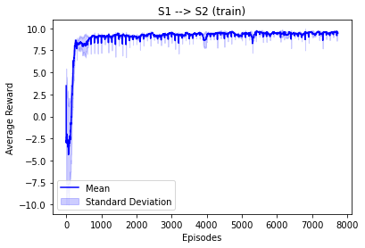
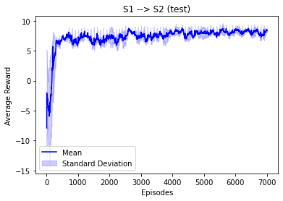
S1 → S2

Slide 7
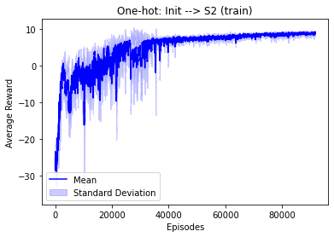
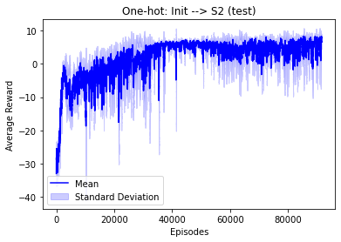
init → S2 (one-hot)

Slide 8
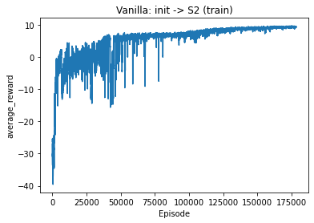
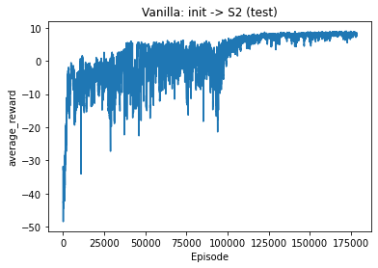
init → S2 (vanilla)

Slide 9
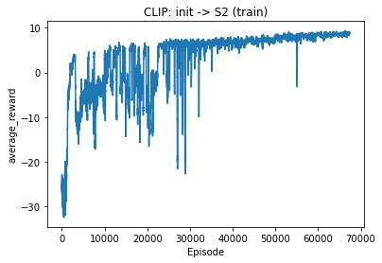
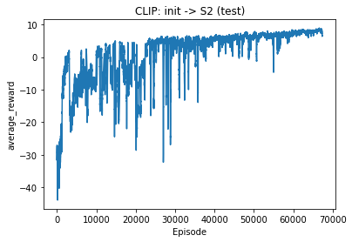
init → S2 (clip)

Slide 10
init → S2 (bert)

Slide 11
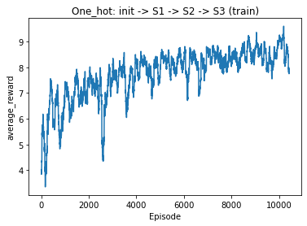
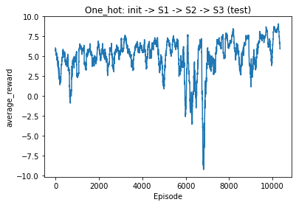
init → S1 → S2 → S3

Slide 12
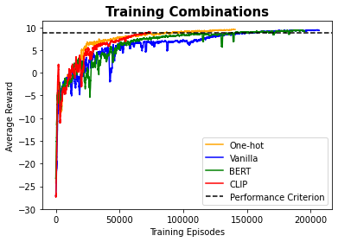
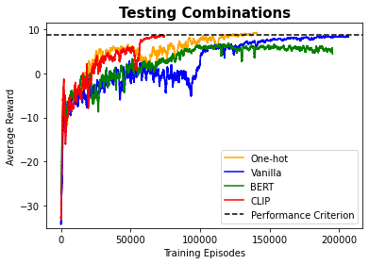

Slide 13
PAPER PLAN
coloured background for easy ref haha

Slide 14
page limit - 7 pages
abstract - zj
introduction - ganesh
related work - ganesh
dataset- env/agent/task
env: refer to hill paper - haidi
agent: model - zj
task: explain what is s0,s1,s2, train test split, performance criteria - haidi & zj
results - exp1/exp2
exp1 - zj
exp2 - haidi
analysis
future work and conclusion
zj: 1, vanilla 2.clip 3. S1b->S1
haidi 1. init s2 w BERT 2.init s2 normal 3.init s1 - s2 from 9.425 expt

Slide 15
Introduction - Ganesh
Cognitive agents such as ACT-R and SOAR are described to have perception, working memory and motor components to learn and deploy relevant skills depending on the task (Laird, 2021). However, these are symbolic agents, where the computation is hand engineered and learning is mostly supervised.
Recent works have developed deep neural agents that can be trained end-to-end using the reinforcement learning regime. Importantly, these agents take in visual inputs and language instructions to solve a large range of tasks using motor actions (Adaptive Agent Team, 2023; Open-Ended Learning Team, 2021)
However, training these agents require 1) large number of training episodes and 2) vastly different environments to perform complex computations that is difficult to elucidate.
Importantly, such inefficient training is not typical of cognitive development where a children learn to integrate vision-language-action together to solve new tasks. Specifically, children learn distinct word groups and instructions through exploration led play on a small set of elements but can generalize to unseen/novel combinations quickly.
To study the efficient learning behaviour of children, we created PlayRoom, a 3D environment to learn 5 objects and 5 colors

Slide 16
Abstract - Haidi
Recent advancements in Reinforcement Learning (RL) agents have showcased their multifaceted capabilities encompassing perception, memory, and motor skills for spatial navigation. However, the extent of their logical reasoning and compositional capability remains unclear. To address this gap, we introduce a 3D environment for investigating agent's navigation within color-object combinations and its capability to understand the novel combinations by reasoning instead of training. We also explore whether different text encoders (vanilla, CLIP, BERT) could facilitate agents to swiftly grasp word combinations and generate coherent text embeddings compared with one-hot encoder. Moreover, some efficient learning strategies of combined words are also discussed. Our results highlight the agent's proficiency in acquiring composition knowledge and its potential for zero-shot learning to generalize to new objects effectively.

Slide 17
Composing Word Groups using Visually Grounded Reinforcement Learning
Abstract - Ganesh
Children before the age of three can understand language-based instructions and navigate to the referred item. Even if they have not seen the combination of queries prior, they can reasonably decompose the instruction to its individual components and infer the novel item. Conversely, deep reinforcement learning agents need to be trained over several thousands if not millions of trials to decently solve navigation tasks grounded to instructions. Furthermore, their ability to generalize to new combinations of instructions is unclear. Hence, we created a 3D playroom-like environment to investigate how deep RL agents learn and compose color-object based combinatorial instructions to solve novel combinations of items in a spatial navigation task. First, we explore if agents can leverage on text encoders (e.g. CLIP, BERT) pretrained on static datasets by supervised learning to learn word combinations faster. Next, we compare the word embeddings of the instructions between the pretrained and vanilla text encoders that learn the object-color word groups by reinforcement to explain the difference in learning performance. Lastly, we demonstrate that if agents are pretrained on the object or color word groups separately, they subsequently learn to solve combinatorial instructions much more rapidly than if the agents are trained directly on the combinatorial instructions. Overall, our results highlight the agent's proficiency in composing word groups through reinforcement learning and its ability to generalize to new combinations of instructions by zero-shot.

Slide 18
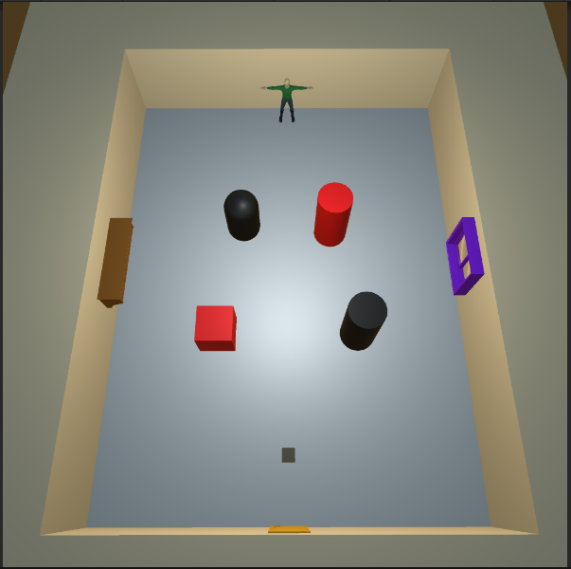
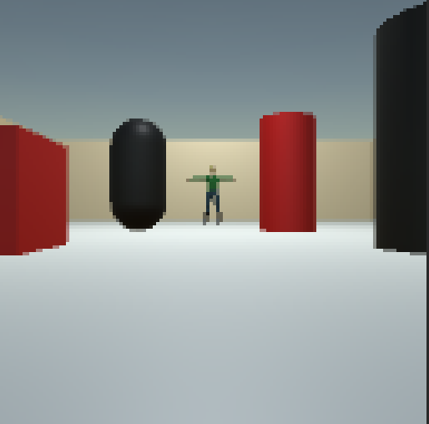
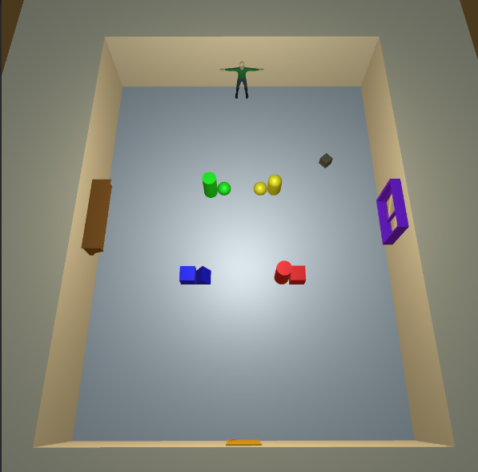
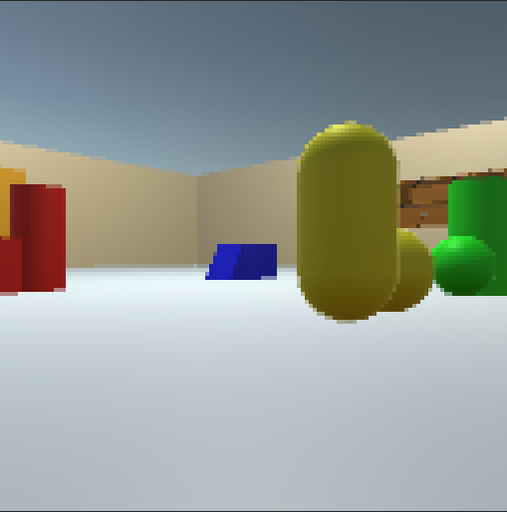
Fig. 1 Example of 3D Playroom
this is for environment subsection
haidi
DONE
Birds eye/top down view - s2
Agent view + Instruction - s2
Composed object env - s3
Agent view + Instruction of the composed objs - s3
example
Possible instructions:
“Red cube”
“black cylinder” -put in captions
-download high res images

Slide 19
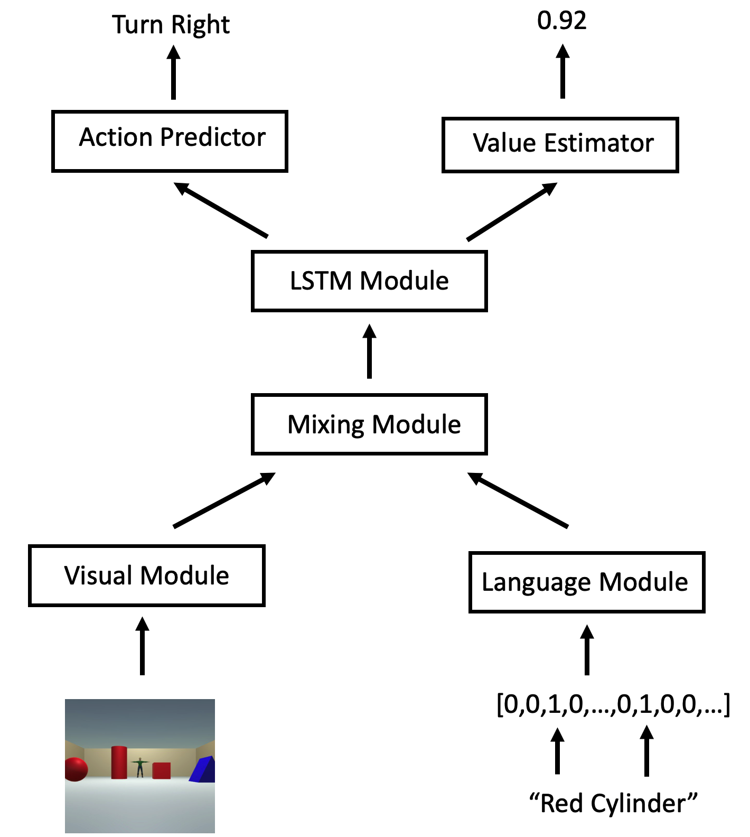
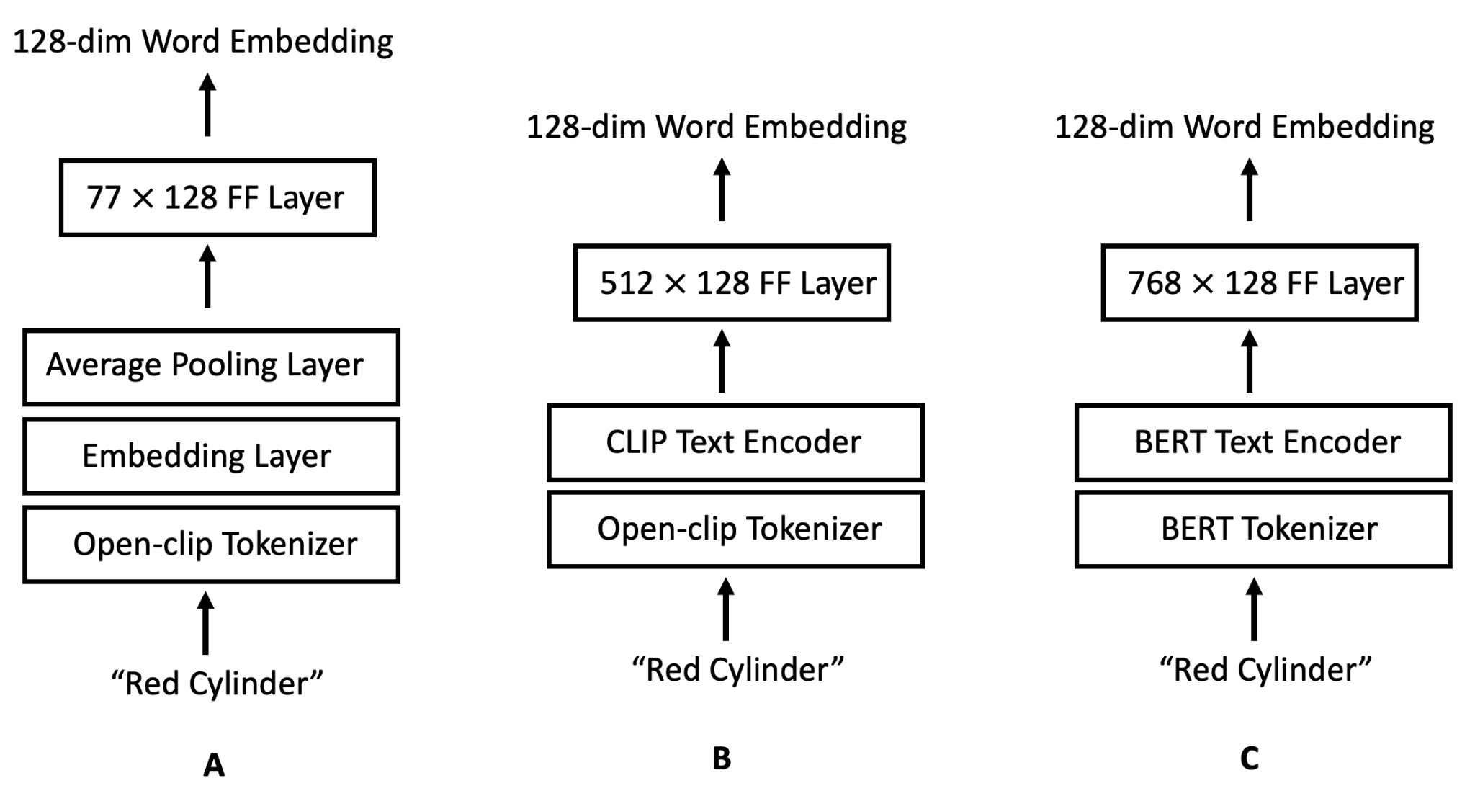
Fig. 2 & 3 RL agent architecture and variants - zijun
this is for agent subsection
indicate process with arrows. CLIP tokenizer → size embedding layer → Avg pooling layer
CLIP not open-CLIP

Slide 20
Fig. 4 Reward curves for one-hot, clip, bert, vanilla
this is for expt 1 section
2 plots Train & test
mean & SD

Slide 21
Table 1: Learning to decompose instructions
this is for experiment 1 section
reward curve in supplementary?
Init → S2 | Train on Color-Object instructions | Test on novel Color-Object instructions
One-hot | mean plus/minus SD
Vanilla
CLIP
BERT
Table 1: Learning to decompose instructions for compositional performance. Agents are trained on 20 color-object pairs and tested on 5 held-out pairs for every 100 episodes. Values in the table indicate the number of episodes needed to achieve a cumulative reward >=9 over 100 episodes (Performance criteria) with standard deviation for 3 iterations. Lower values indicate faster learning performance.

Slide 22
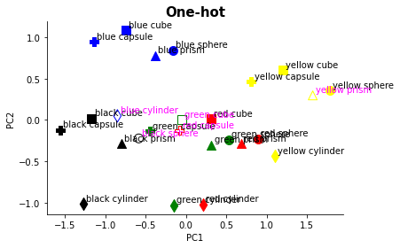
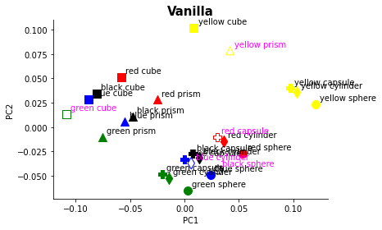
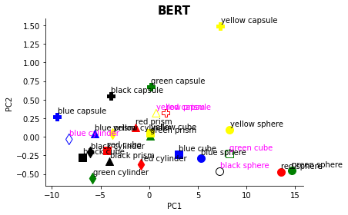
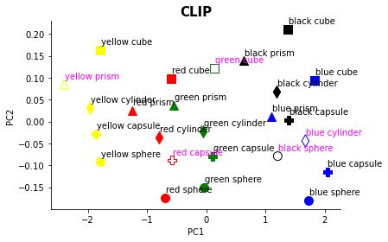
Word embeddings of different text encoders when episode is 50k
R=7?
R=3.5
R=8?
R=3.5

Slide 23
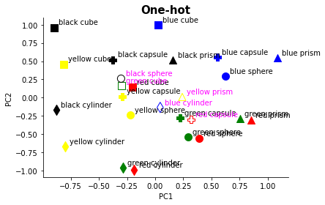
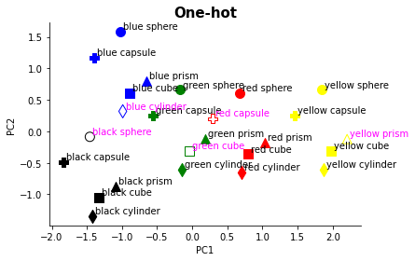
one-hot

Slide 24
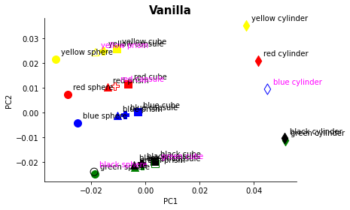
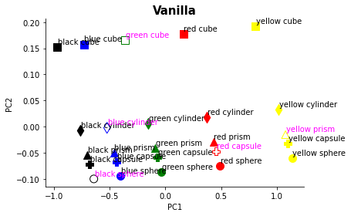
vanilla

Slide 25
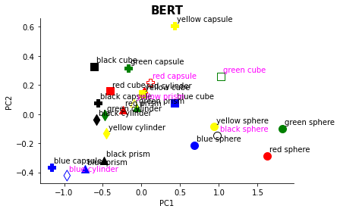
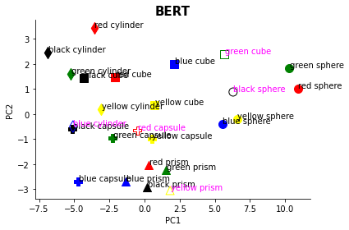
bert

Slide 26
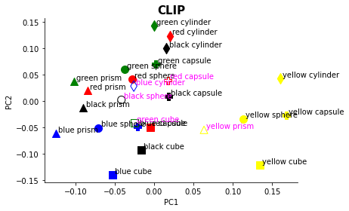
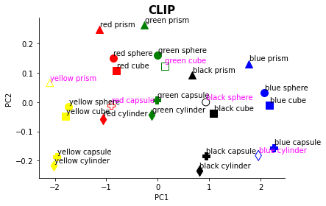
clip

Slide 27
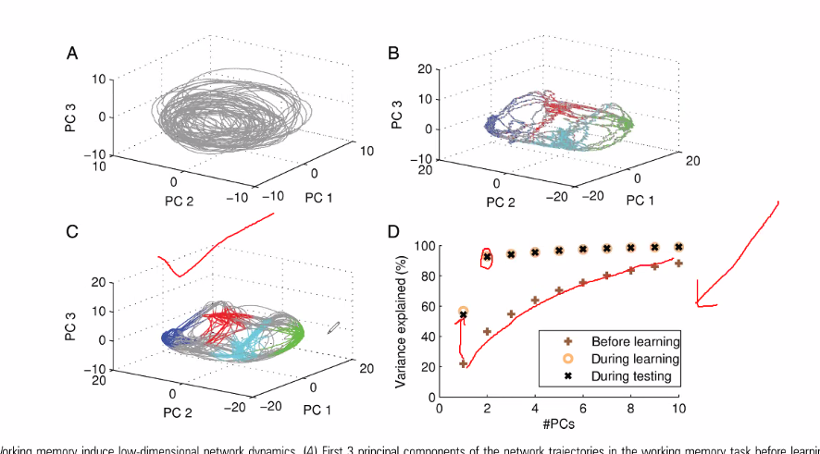
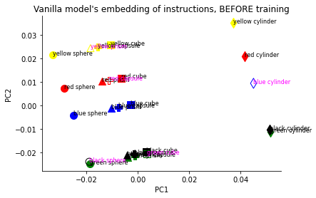
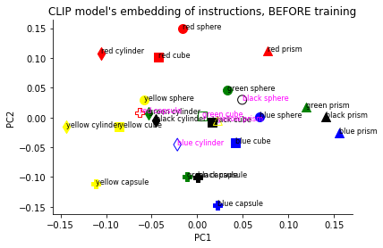
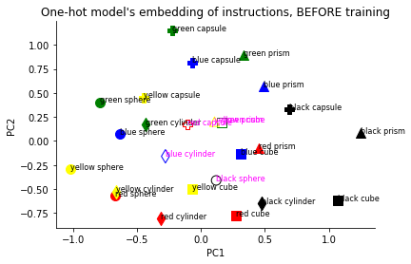
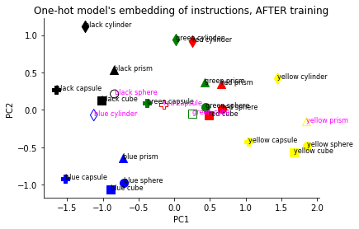
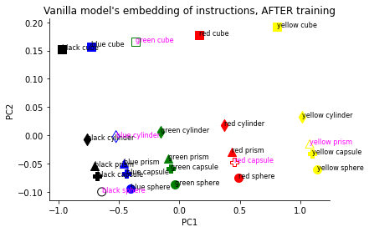
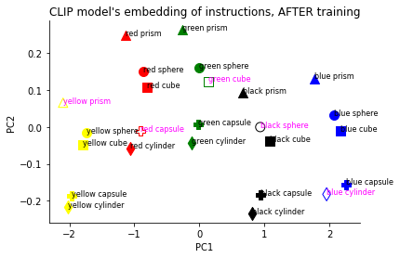
Fig. 3 Representations learned by agents
20 + 5 clusters corresponding to train (circle) & test (cross) combinations
PCA/T-SNE of Text encoder 128 FF layer of one-hot, vanilla, CLIP, BERT after training
pass the 20 train words into the text encoder & get the 128 embedding vector
pass the 20 x 128 matrix into PCA/T-SNE using pca.fit_transform → 20 x 3-N matrix (sklearn n_components=0.95)
plot/scatter plot of the 20 rows with different colors using the 1st and 2nd dimensions
pass 5 test words into PCA/T-SNE using pca.transform → 5 x 3 matrix
overlay scatter plot of 5 rows to see how test words are embedded in the train representational space
PCA/T-SNE of Text encoder 128 FF layer of one-hot, vanilla, CLIP, BERT before training (supplementary)
Notes:
pass one-hot information to 1 layer randomization

Slide 28
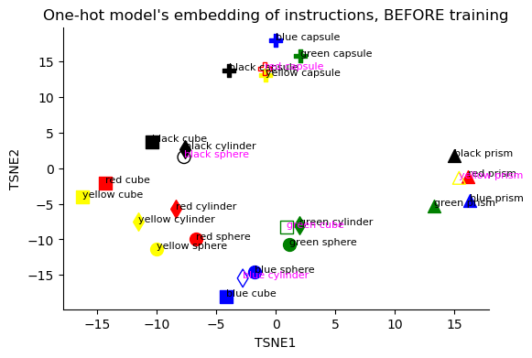
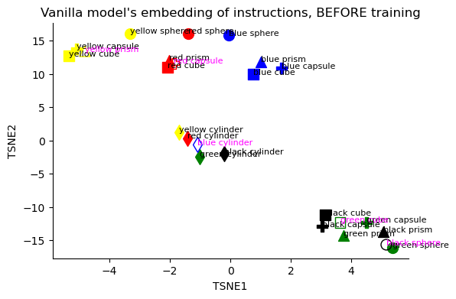
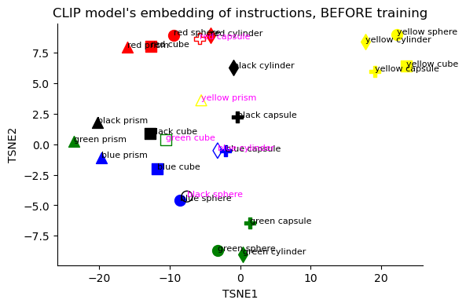
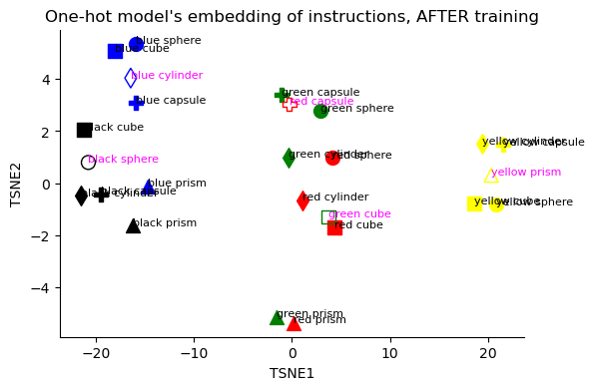
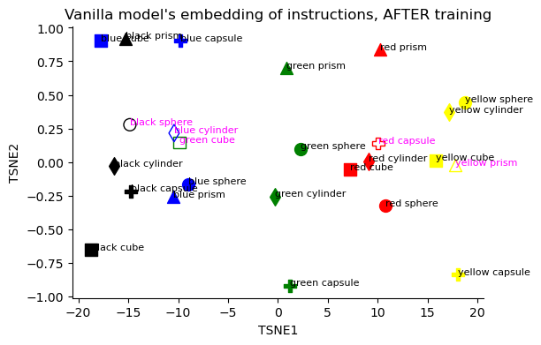
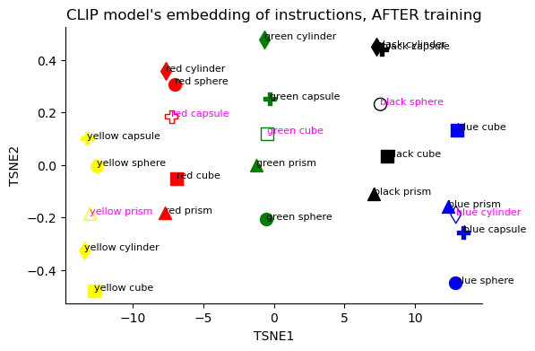
Fig. 3 Representations learned by agents_TSNE
20 + 5 clusters corresponding to train (circle) & test (cross) combinations
PCA/T-SNE of Text encoder 128 FF layer of one-hot, vanilla, CLIP, BERT after training
pass the 20 train words into the text encoder & get the 128 embedding vector
pass the 20 x 128 matrix into PCA/T-SNE using pca.fit_transform → 20 x 3-N matrix (sklearn n_components=0.95)
plot/scatter plot of the 20 rows with different colors using the 1st and 2nd dimensions
pass 5 test words into PCA/T-SNE using pca.transform → 5 x 3 matrix
overlay scatter plot of 5 rows to see how test words are embedded in the train representational space
PCA/T-SNE of Text encoder 128 FF layer of one-hot, vanilla, CLIP, BERT before training (supplementary)

Slide 29
Table. 2 Concept learning speeds up compositional learning
this is for expt 2 - haidi
0-shot Expt | train | test
s1 > s2 | 7.31 | 4.43
init > s2 (one hot) | -29.1,3.07 | -36.5,3.60
s1 > s3 | -0.20 | -7.29
init > s3 (one hot) | -24.4,1.29 | -23.4,2.57
s1,s2 > s3 | 5.49,0.26 | 5.55,0.39
init,s2 > s3 | 2.84,0.92 | -5.10,2.59
Expt | train | test
s1 > s2 | 638 +- 130 | 5474+-2877
init > s2 (one hot) | 67415+-7191 | 94811+-3729
s2 > s3 (pending, if need add in) | ave +-std | ave +-std
init,s2 > s3
1 and 3, train

Slide 30
Table. 2 Concept learning speeds up compositional learning
 | Zero-shot evaluation
Training envs | familiar c+s combo | unseen c+s combo
C/S
Nil
Training envs | familiar c+s+s combo | unseen c+s+s combo
c/s → c+s
c+s
2 hlines

Slide 31
Fig. 4 Representations learned through concept learning
20 + 5 clusters for train & test instructions
PCA/T-SNE of 128 FF layer after training on S1
PCA/T-SNE of 128 FF layer after training on S1→ S2
50 clusters for train & test
PCA/T-SNE of 128 FF layer before training on S3
PCA/T-SNE of 128 FF layer after training on S3

Slide 32


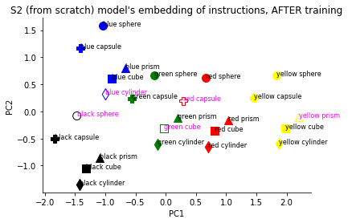
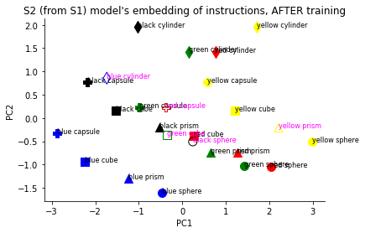
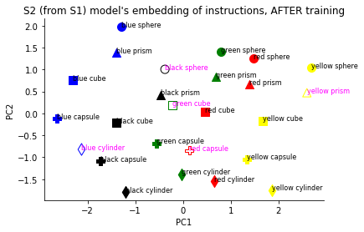
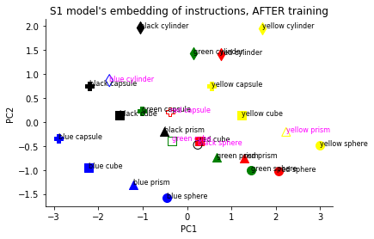
Fig. 4 Representations learned through concept learning
Reward:9
Reward:10
After S1 training
Reward:9
Reward:10

Slide 33
Fig. 4 Representations learned through concept learning
Before
After (high 9, almost 10)

Slide 34
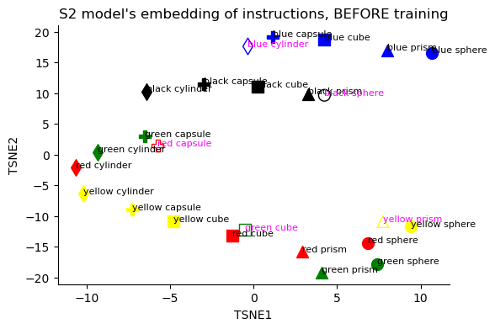
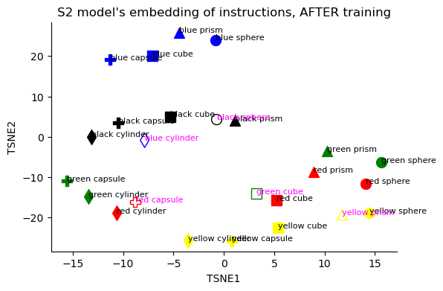
Fig. 4 Representations learned through concept learning_TSNE

Slide 35
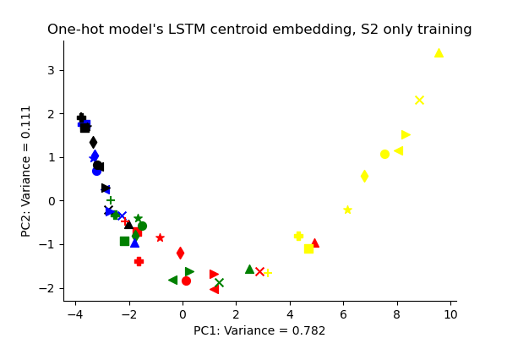



Zero-shot composition with concept learning

Slide 36


Supplementary tables - table 1&2 train test splits - haidi
table 2

Slide 37
supplementary figures
Average reward curves with std for all expts
Latency curves - number of steps to complete episode
Loss curves?
Video of agent solving tasks, youtube link
Sample Code to run unity file (write short code snippet and ss - use VS code)
load unity build
get observation
step action
get reward

Slide 38
Intro
Keywords:
Embodied agent, language grounding to vision & action, zero-shot composition
Background:
Ground embodied visual agents using language
LLMs trained on large corpus achieve decent logical reasoning by decomposing/parsing sentences and sequentially ordering instructions.
Ref: ChatGPT QnA
But they are not grounded to visual information or perform spatial navigation.
Embodied RL agents can perform spatial navigation but not logical reasoning or compositionality.
Question:
How well do vision-text RL models compose new textual instructions for zero-shot navigation?
Can RL models leverage on pretrained VLM (Vision and/or Text) representations for fast mapping to new objects?

Slide 39
Related works
Compositionality in RL agents
Model-free algorithms learn habits or inflexible policies
Unsure if model-free agents can decompose instructions to genearlize to new combinations
Kumar 2022, McClelland 2013, Open-Ended Learning team, adaptive agent team
Language Grounding via RL
RL agents can learn to be flexible using language as an abstract instruction
Jiang, Finn 2019 - HER to relabel agent trajectory to learn language instructions
However, most works
Hermann 2017; Chaplot 2017; Shu, Xiong, Socher 2019
Integrating pretrained encoders into Embodied agents
Radford 2021 ICML: CLIP encoders integrated with agent?
Voyager: GPT to generate code to solve RL, but GPT trained on instructions
VLM serves as a annotater to increase efficiency of embodied agent’s learning

Slide 40
Language learning environment
Environment
Room with visual cues & avatar
4 possible reward locations
Types of objects
Types of colors
Types of agent & training procedure
Onehot, vanilla text, CLIP, BERT
A2C
Task
Objectives of S0, S1, S2
Train vs Test split table
Evaluation metrics: Performance critiera, Reward, Latency to reach target
Goal: Solve/generalize for S2 test with as little training [motivation for paper]

Slide 41
Expt 1: Agent decomposes instructions to generalize
Theory
Learn O1-C1, O1-C2, O1-C3, O2-C1, O2-C2, O2-C3
Can generalize both object and colour? ON-CM?
Agent generalizes from familiar to novel combination of object & colour
Init → S2
Agent learns to decompose familiar combinations & combine categories to solve novel combinations (train-test split):
Train:
Learn Red colour: red cube, red sphere, red prism, red cylinder
Learn Capsule object: green capsule, blue capsule, yellow capsule, black capsule
Test:
Combine Red + Capsule: Red capsule
Do pretrained text encoders improve generalization performance?
Compare (Onehot, Vanilla text, CLIP text, BERT)

Slide 42
Expt 2: Curriculum X Learning → Foundational learning
learning individual concepts is harder than combined concepts
i.e. S1 is harder than S2
evidence:
init → S1 200k eps vs init → S2 75k eps
init → S2/S1a/S1b → S1 100k eps
after learning individual concepts, learning combined concepts is much easier
evidence:
S1 train → S2 test 4k eps
init → S2 test 90k eps

Slide 43
Expt 3? Hindsight Experience Replay
Episode X
Currently:
Instruction: “red cube”
Agent navigates to “blue sphere”
Reward = 0
HER:
Relabel instruction to “blue sphere”
Train the agent on the same trajectory but with the relablled instruction
-3
-3
+10
inst: red cube
blue sphere
green cube
+10
red cube
+10
+10

Slide 44
Expt 4?: Visual encoders + Text encoders

Slide 45
Analysis 1: Learned representations of text encoders
get the neural embeddings of the final layer before mixing layer (128 unit layer)
for S1 & S2
For Onehot, vanilla, CLIP, BERT
Perform dimensionality reduction ← PCA, LDA, T-SNE
Plot the organisation/similarity of instructions
Do Pretrained text encoders incorporate organization of instructions?
see whether the organisation by RL is similar to that by pretrained text encoders by SL
if by RL is similar or better: we say that the encoding representations are okay to be learned thru RL
if by RL is worse: we say that encoding rep by SL is better
NLP plots of cosine distance between synonyms:
Colours: Red vs blue vs green vs yellow
Objects: Prism vs cube vs …
Colours & objects:

Slide 46
Experiments

Slide 47
Discussion/Limitations/Conclusion/Future Works

Slide 48
other ideas
use the current agents and create test env of different intermediate colours, e.g. test env pass a new color like orange and see which colour the agent travels to, test intermediate colours between RGBYBla
can try with objects if have time
whether the pre-trained model can facilitate the training process (10 episodes)
using longer sentences for captions, instruction-like, e.g. pass me the red cube
can use template of N captions and the target is inserted into caption (f-string)
use LLM to generate the caption based on a prompt (e.g. GPT, etc)
using vision encoders
using multi agents

Slide 49

Train - Test Split
From Scratch → S0
From Scratch → S1
S0 → S1
From Scratch → S2
S0 → S2
S1 → S2
S0 → S2 (Vanilla / Pretrained Text Encoder)
Performance criteria = 0.95 reward over 100 episodes.
Determine when performance criteria is reached.
Notes:
meeting:
organise the experiments nicely

Slide 50
Performance summary for one-hot encoded text agent
Qn: Does curriculum learning help RL agents learn to compose familiar & novel word concepts faster?
Stage | HyperParameters | Training episodes to performance criteria of atleast 9 reward for last 100 episodes (N=3) | Testing episodes to performance criteria of atleast 9 reward for last 100 episodes (N=3) | Use S2 model weights, test on S1 train and test env (2 values - train test) 100 eps
Init → S0 → S1 → S2 | onehot | 10138 → >200k→ 8982 | 10878 → >200k → 22675 | -0.41/-7.56 Accuracy: 72%/59%
Init → S0 → S2 (haidi) | onehot | 10138 → 80836 | 10878 → 116353 | -1.89/-2.54 Accuracy: 41%/37%
Init → S1 → S2 (haidi) | onehot | 176662 → ? | ? → ?
Init → S2 | onehot | 74050 | 99428 | -2.5/-6.86 Accuracy: 60%/53%
S0 → S1 | onehot | >200k | >200k | -
S0 → S1a → S1 | onehot | 49943 → 43602 | _ | -
S0 -> S1b -> S1 |  | 35482 → 52778 | _
Init -> S2 -> S1 (zijun) |  | 74050 → 32162 | could not reach 9
Init -> S0 -> S2 -> S1 (haidi) |  | 10138 → 80836 → 10533 | could not reach 9

Slide 51
Performance summary for one-hot encoded text agent
Qn: Does curriculum learning help RL agents learn to compose familiar & novel word concepts faster?
Stage | HyperParameters | Training episodes to performance criteria of at least 0.7 accuracy for last 100 episodes (N=3) | Testing episodes to performance criteria of atleast 0.7 accuracy for last 100 episodes (N=3) | Use S2 model weights, test on S1 train and test env (2 values - train test) 100 eps
Init → S0 → S1 → S2 | onehot | 1866 → ?→ 2869 | 1435 → ? → 5705 | -0.41/-7.56 Accuracy: 72%/59%
Init → S0 → S2 (haidi) | onehot | 1866 → 6418 | 1435 → 53778 | -1.89/-2.54 Accuracy: 41%/37%
Init → S1 → S2 (haidi) | onehot | ? → ? | ? → ?
Init → S2 | onehot | 22731 | 28063 | -2.5/-6.86 Accuracy: 60%/53%
S0 → S1 | onehot | >200k | >200k | -
S0 → S1a → S1 | onehot | ~100k | ~100k | -
S0 -> S1b -> S1
Init -> S2 -> S1 (zijun)
Init -> S0 -> S2 -> S1 (haidi)

Slide 52
Performance summary with LLM agent
Qn: Do pretrained text encoders help RL models learn instructions faster? and generalize faster/better?
Stage | HyperParameters | Training episodes to performance criteria of atleast 9 for last 100 episodes (N=3) | Testing episodes to performance criteria of atleast 9 for last 100 episodes (N=3)
S0 → S2 | Onehot | 80836 from previous slide | 116353 from previous slide
Init -> S2 | CLIP tokenizer + Vanilla text encoder | 92024 | -
S0 → S2 | CLIP tokenizer + CLIP text encoder | ? | ?
S0 → S2 | BERT tokenizer + BERT text encoder | ? | ?
S0 → S1 → S2 | CLIP text encoder | ? → ? | ? → ?
S0 → S1 → S2 | BERT text encoder | ? → ? | ? → ?

Slide 53


From Scratch → S0, lr = 2.5e-5
10138 | 9
19793 | 10
10878 | 9
18371 | 10
Notes:
too easy may not need to put in paper

Slide 54
From Scratch → S1

Slide 55

S0 → S1
9.845 (lr:3.5e-5) → unstable, collapses sometimes
The learning rate suitable for S1a/S1b may not work well for S1. Currently, try to use lower learning rate (2.5e-5) → try to fix lr to all exps

Slide 56


init → S2 → S1

Slide 57

From Scratch → S2
Test best models on train/test env
 | train | test
199999.pt | 6.5 7.15 7.48 | 6.16 6.43 4.6
199863.pt | 7.51 7.81 7.21 | 6.19 5.59 6.7
199999.pt seems to be best model
need train some more

Slide 58


S0 → S2
Train Env
Test Env
Observation; for first 50k eps, model performance on test env is very poor (in the negatives) compared to training (above 0), but gradually improves showing that agent has learnt diff attributes and have become generalised over more eps

Slide 59


S1 → S2
8982 | 9
26786 | 10
22675 | 9
32666 | 9.28

Slide 60


From Scratch → S2 Vanilla Text Encoder
92024 | 9
198396 | 9.97

Slide 61


init → S1
caa040823 830am
176662 | 9
196586 | 9.425
192790 | 6
196448 | 6.245

Slide 62


init → S2
caa010823 5pm
74050 | 9
179890 | 10
99428 | 9
166767 | 9.89

Slide 63


from S0 → S2
caa010823 5pm
80836 | 9
144717 | 10
116353 | 9
138359 | 9.575

Slide 64

From S0 → S2 BERT Text Encoder
caa010823 5pm
 | 9
68043 | 8.89

Slide 65


init S0 S2 → S1
caa040823 9am
10533 | 9
67750 | 9.91
4153 | 7.29

Slide 66


init S0 → S2 BERT
caa040823 9am
2306 | 6.17
1723 | 3.92

Slide 67




S1 → S2
caa050823 11.37pm
808 | 9
47878 | 10
1900 | 9
86100 | 10

Slide 68


init → S2, intermediate results
caa070823 9.44am
previous best results init > s2
train: 9 - 74,050
test: 9 - 99,428
still got chance get better results with this expt
 | 9
 | 10
 | 9
 | 10

Slide 69


init → S2 w BERT 1, intermediate results
caa070823 9.44am
 | 9
 | 10
 | 9
 | 10

Slide 70


init → S2 w BERT 2, intermediate results
caa070823 9.44am
 | 9
 | 10
 | 9
 | 10

Slide 71
haidi results

Slide 72

210723 Friday s2_9 - train from S0 best results, 200k eps, no skips steps, speed 3, lr=3.5e-5
Test best models on train/test env
 | train | test
199999.pt | 9.88 9.97 9.85 | 9.55 9.49 9.58
176977.pt | 9.82 9.82 9.7 | 9.28 9.28 9.58
199999.pt seems to be best model

Slide 73

210723 Friday
s2_10 - train from S0 best results, 200k+ 60k eps, no skips steps, speed 3, lr=3.5e-5
Test best models on train/test env
 | train | test
199999.pt | 9.85 9.85 10 | 9.4 9.76 9.05
104145.pt | 9.86 10 9.91 | 8.05 8.7 8.6
199999.pt seems to be best model

Slide 74
230723 Sunday
s2_11 - train from scratch, 200k eps, no skips steps, speed 3, lr=3.5e-5
Test best models on train/test env
 | train | test
199999.pt | 6.5 7.15 7.48 | 6.16 6.43 4.6
199863.pt | 7.51 7.81 7.21 | 6.19 5.59 6.7
199999.pt seems to be best model

Slide 75
240723 Monday
s2_13 - train from S0, 200k eps, alt train test, speed 3, lr=3.5e-5
Train Env
Test Env
Observation: for first 50k eps, model performance on test env is very poor (in the negatives) compared to training (above 0), but gradually improves showing that agent has learnt diff attributes and have become generalised over more eps

Slide 76


260723 Wednesday
s0_final_1&2 - train from scratch, 23k eps, alt train test, speed 3, lr=2.5e-5
Train Env
Test Env
Observation:

Slide 77
260723 Wednesday
s0_final_1&2 - train from scratch, 23k eps, alt train test, speed 3, lr=2.5e-5
Test best models on train/test env
 | train | test
7999.pt | 7.27 7.96 8.35 | 7.66 8.05 8.2
7861.pt | 8.65 8.77 8.77 | 8.77 8.83 8.02
7861.pt seems to be best model

Slide 78


310723 Sunday
still training
Expt A - from scratch to S2, ~100k eps, alt train test, speed 3, lr=2.5e-5
Train Env
Test Env
Observation: training is pretty stable for 100k episodes but model performance on test is quite erratic and unstable

Slide 79


310723 Sunday
still training
Expt B - from scratch to S1, ~70k eps, alt train test, speed 3, lr=2.5e-5
Train Env
Test Env
Observation: training is unusually worse than from scratch to S2, for the previous expt, the training was pretty decent and stable after 70k eps. training here seems to plateau at 5? performance on test is terrible

Slide 80


310723 Sunday
still training
Expt C - from S0 to S2, ~130k eps, alt train test, speed 3, lr=2.5e-5
Train Env
Test Env
Observation: model is still training after 130k eps, seems like plateauing but might be able to train further. performance on test still not that great, overfit?

Slide 81

310723 Sunday
still training
Expt E - from S0 to S2 with new BERT, ~24k eps, train env only, speed 3, lr=2.5e-5
Train Env
Observation: model is still training after 130k eps, seems like plateauing but might be able to train further. performance on test still not that great, overfit?

Slide 82


init → S2 w BERT 1, intermediate results
caa080823 10.20pm
 | 9
 | 10
 | 9
 | 10

Slide 83


init → S2 w BERT 2, intermediate results
caa080823 10.20pm
 | 9
 | 10
 | 9
 | 10

Slide 84


init → S2, intermediate results
caa080823 10.20pm
70703 | 9
111261 | 9.88
94778 | 9
108933 | 9.51

Slide 85
110823 meeting

Slide 86



init -> s2 clip, intermediate results,
s2 clip 1,2,3,4 interm
caa130823 11am
 | 9
 | 9

Slide 87


init -> s2 bert , intermediate results
s2 bert 1,4,6,8 interm
caa110823 4pm
 | 9
 | 9

Slide 88


init -> s2 bert , intermediate results
s2 bert 2 interm + s2 bert 5 interm
caa110823 4pm
96163 | 9
120172 | 9.4
 | 9
 | 9

Slide 89
final results haidi
150823

Slide 90


init -> s2 bert 1
caa160823 630pm

Slide 91


init -> s2 bert 2
caa160823 630pm

Slide 92




init -> s2 clip 3
caa150823 6pm

Slide 93


init,s2 -> s3 1
caa150823 6pm

Slide 94


init,s2 -> s3 2
caa150823 1230pm

